Slide 1


Exploration of semi-active control approaches for the Two Axis aDaptable Ankle (TADA)
Kieran Nichols, M.S.
Advisor: Peter Adamczyk Ph.D
Co-author: Becca Roembke
Notes:
Need to include pictures of me, Peter, UW, and the lab

Slide 2
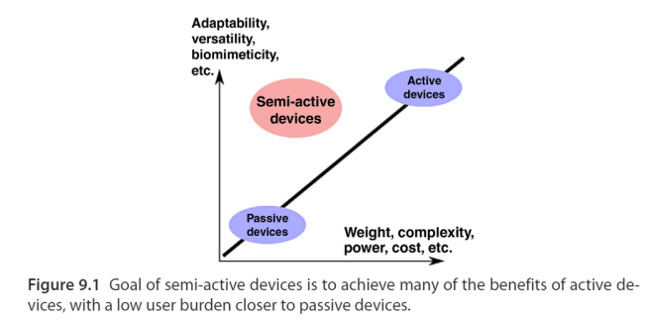
Semi-active prostheses
Various considerations in developing passive, active, and semi-active prostheses from Adamczyk (2020)¹
Notes:
Add background about the need of semi-active prostheses
What are semi-active prostheses
What can it help with?
Maybe 2 slides

Slide 3
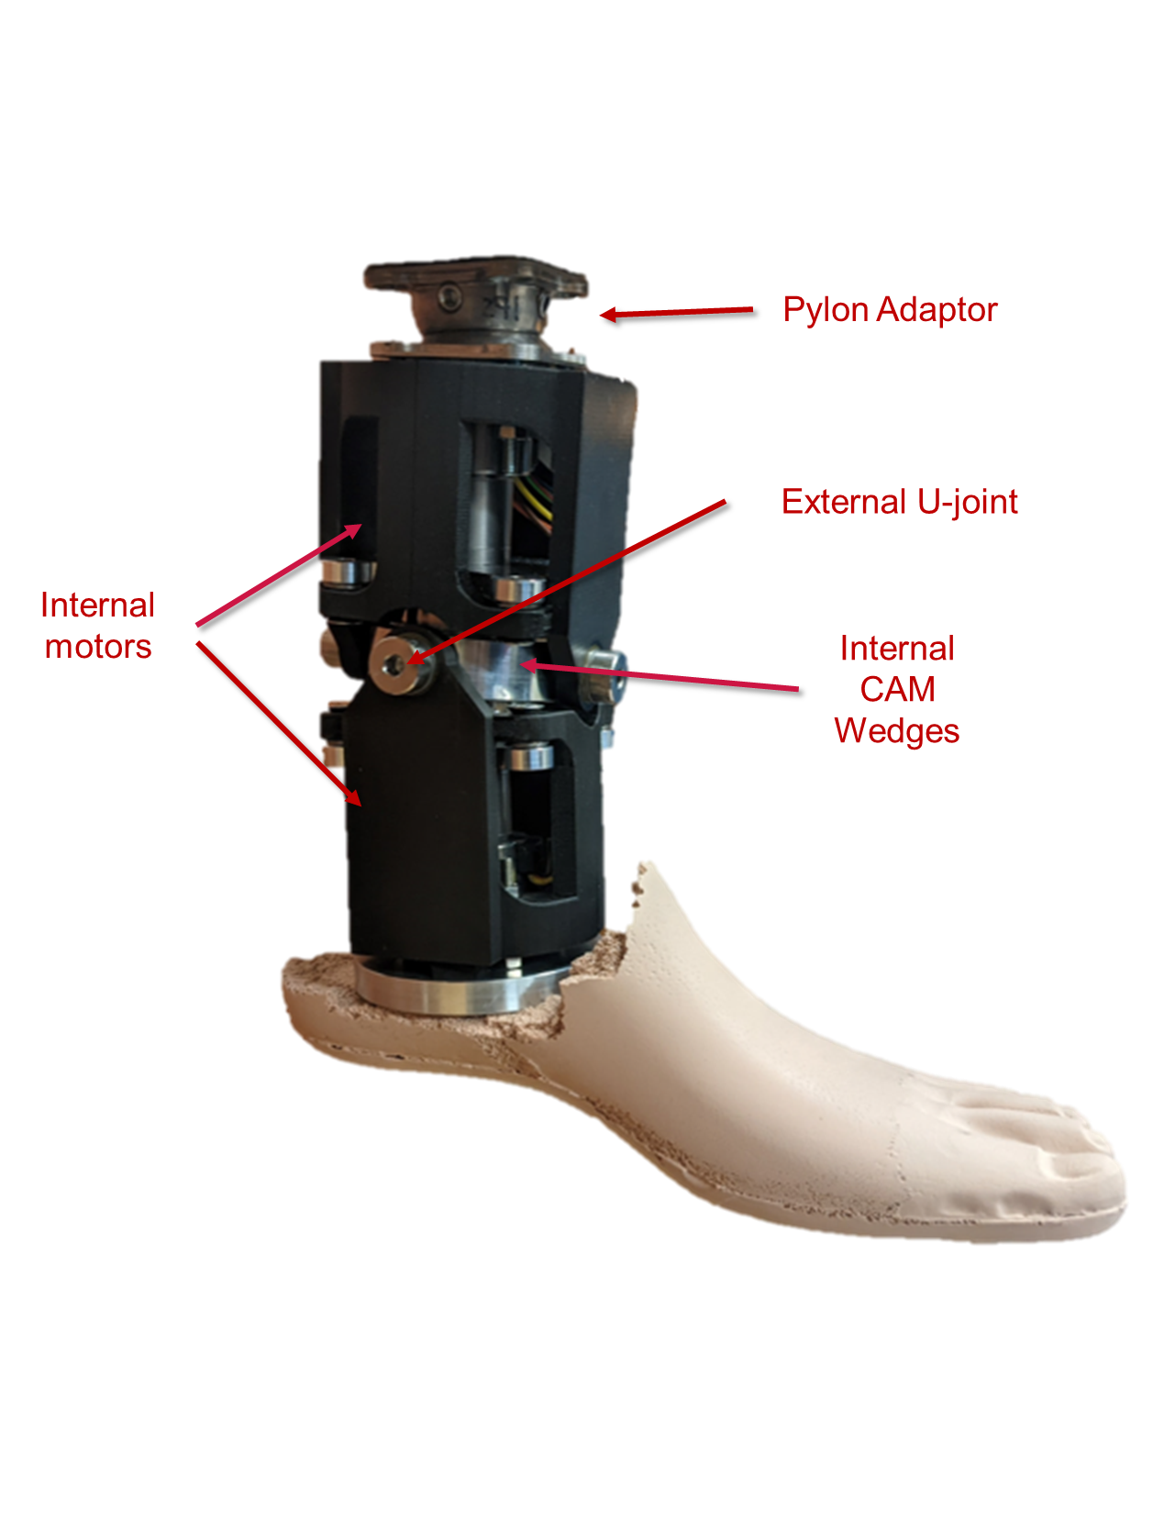
Background
TADA: semi-active (moves in swing) ± 10 deg sagittal and/or frontal
Sensing: IMU – encoders – load cell (Fz, Mx, My)
Notes:
Add video of tada moving?

Slide 4
How to control a semi-active TADA?
Ideal Swing phase trajectory?
Right way for the TADA to adapt to the slope?
Optimal ankle angle control to target specific ankle moments?

Slide 5
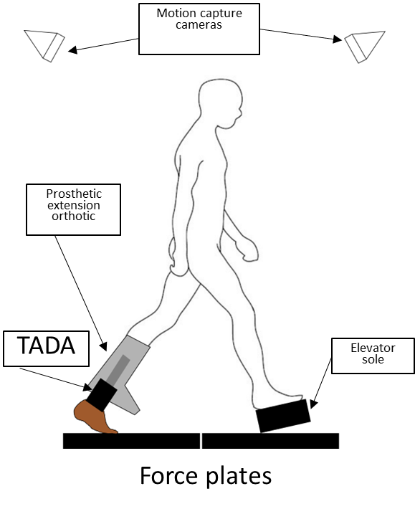
Method
Walk at a self-selected speed using TADA angles
Starting neutral angle (90° dorsiflexion and no eversion)
Use a range of angles from ± 10 deg from neutral
plantarflexion (PF)
dorsiflexion (DF)
eversion (EV)
inversion (IV)
Notes:
Make graphic of PEO?

Slide 6
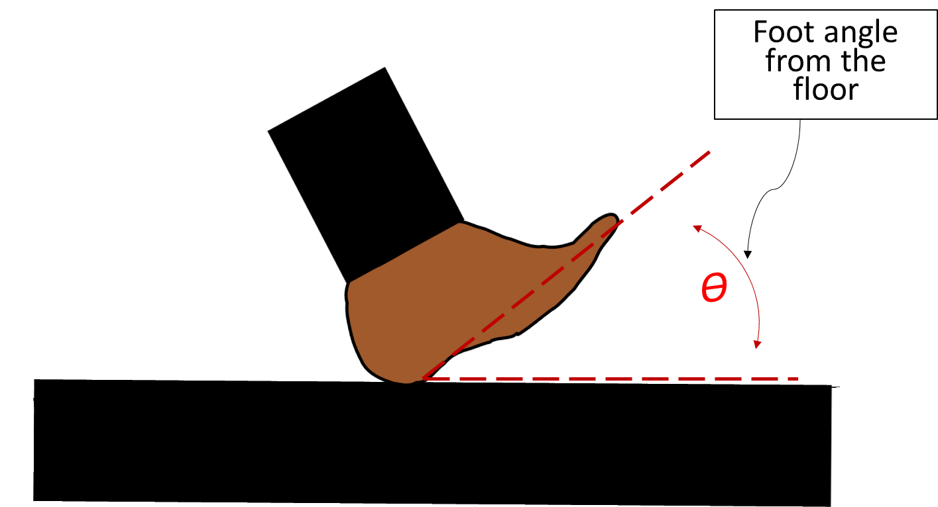
Ankle Angle Control
Initial tuning of neutral stance angle to user-preference
Evaluate peak ankle moments during stance
High peak ankle moments in prostheses may contribute to ankle and knee injuries
How does various ankle angles affect ankle moments?

Slide 7
Ankle Angle Control
First, walk with neutral TADA
Then the TADA moves to perturbed angle during swing phase
TADA moves back to neutral
TADA will calculate ankle moment from load cell
Lab tests with non-disabled persons
Validation study for TADA’s capability to detect ankle moment

Slide 8
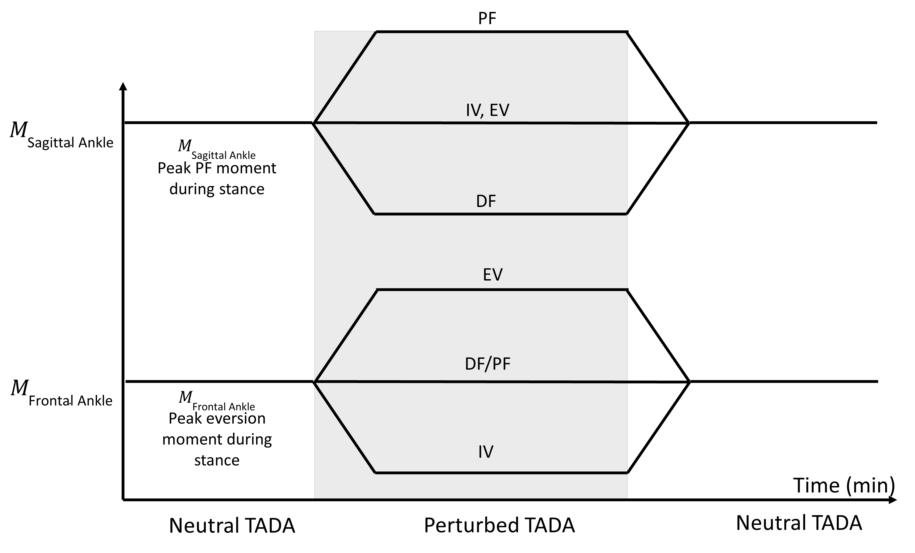
Ankle Angle Control
Notes:
Is it hypothesis?; need to state clearly the hyposthesis
First we control it to clear angles, clear toes, clear slopes, and moments.
Focus on moments
To give info about this feeding into anti. And momenting trargeting
Confirm with Peter the directionality

Slide 9
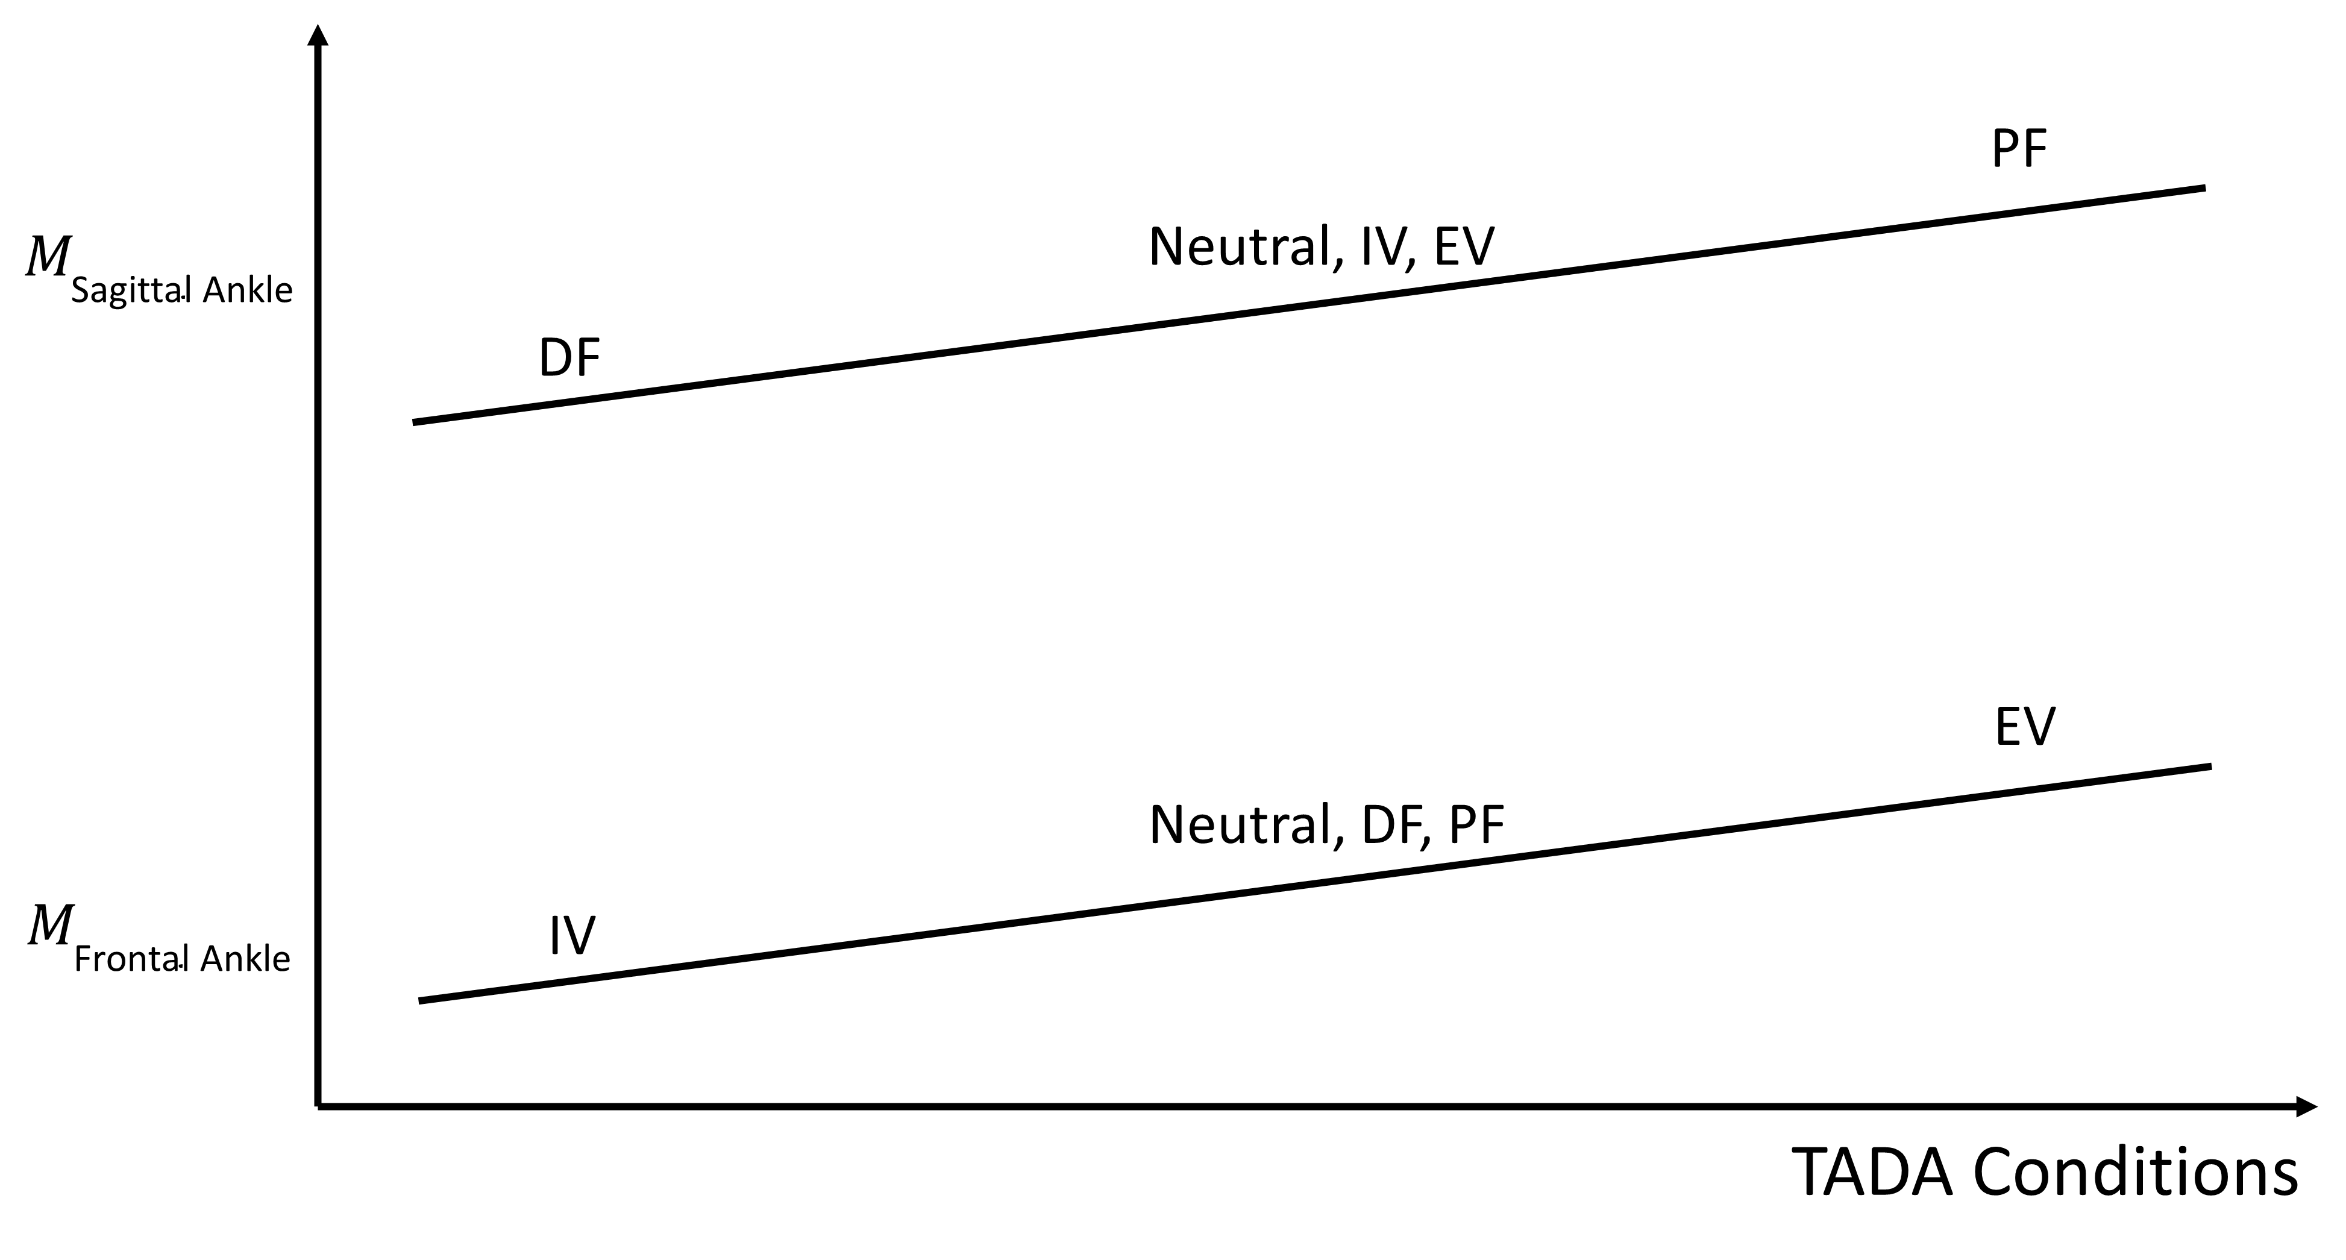
Ankle Angle Control

Slide 10
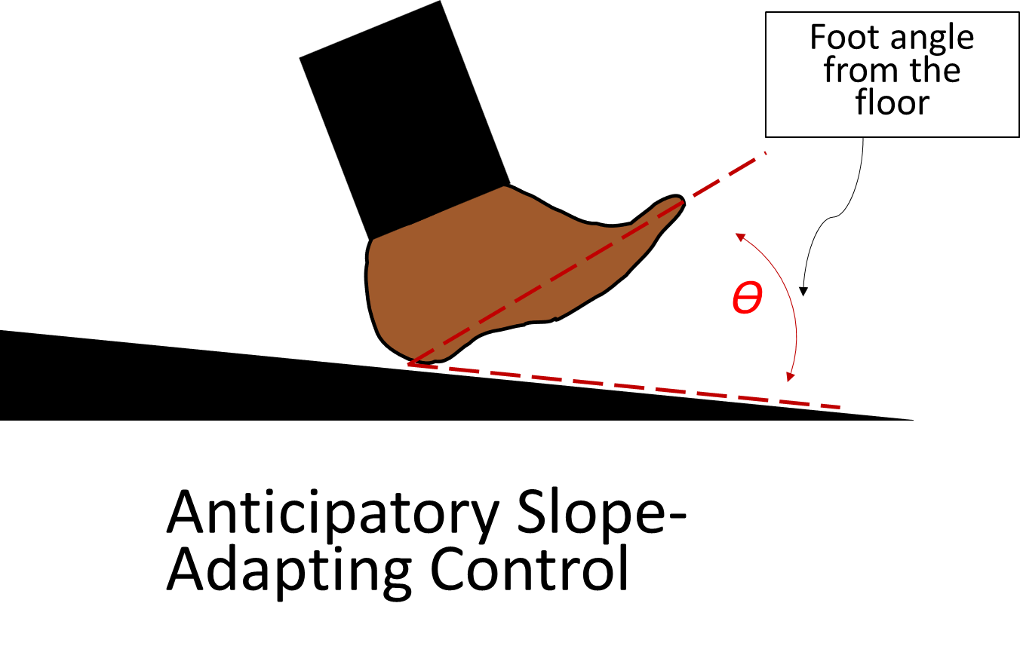
Ankle Angle Control
Results of Ankle Angle Control will give the sensitivity of ankle angle and moment in the TADA
Can be used to build an Anticipatory Slope-Adapting Approach
Anticipatory Approach
Slope-Adapting
Notes:
DF, Neutral, IV, EV, and PF
If I do Aim 1,
If I want more consistent,
Present ankle moment sagittal and frontal
Frontal: Neutral, PF, DF moments
Sagittal: DF, Neutral/IV/EV, and PF (mechanically should be but behaviorally they could be different)
MTC: neutral

Slide 11
Anticipatory Slope-Adapting Control
Initial tuning of stance angle to user-preference
Evaluate peak ankle moments
High peak ankle moments in prostheses may contribute to ankle and knee injuries
Does adapted stance angles have lower peak ankle moments?
Notes:
Two steps into the sequence; it will be informed by theoretical
Perturbation study to get ASAC
Neutral is what settle

Slide 12
How to control a semi-active TADA?
Ideal Swing phase trajectory?
Right way for the TADA to adapt to the slope?
Evaluate the sensitivity of ankle angle and peak ankle moment in the TADA
Optimal ankle angle control to target specific ankle moments?

Slide 13
Remaining Goals and Challenges
Moment-Targeting Control
Sensing terrain
Remembering slope
Predictive and volitional control
Human-in-the-loop optimization
Osseointegration bi-directional neural interface
Notes:
Sensitivty of ankle angle and moment of TADA
Don’t talk in detail about moment-targeting

Slide 14
TADA motor control
References
1) Adamczyk, P. G. Chapter 9 - Semi-active prostheses for low-power gait adaptation. in Powered Prostheses (eds. Dallali, H., Demircan, E. & Rastgaar, M.) 201–259 (Academic Press, 2020). doi:10.1016/B978-0-12-817450- 0.00009-2.
2) Johnson, L., De Asha, A. R., Munjal, R., Kulkarni, J., & Buckley, J. G. (2014). Toe clearance when walking in people with unilateral transtibial amputation: effects of passive hydraulic ankle.
2) Wu, A. R., & Kuo, A. D. (2016). Determinants of preferred ground clearance during swing phase of human walking. Journal of Experimental Biology, 219(19), 3106-3113.
Acknowledgments
This work is supported by the DOD grant (W81XWH-20-1-0884) and institutional funds from the University of Wisconsin–Madison.

Slide 15
Extra

Slide 16
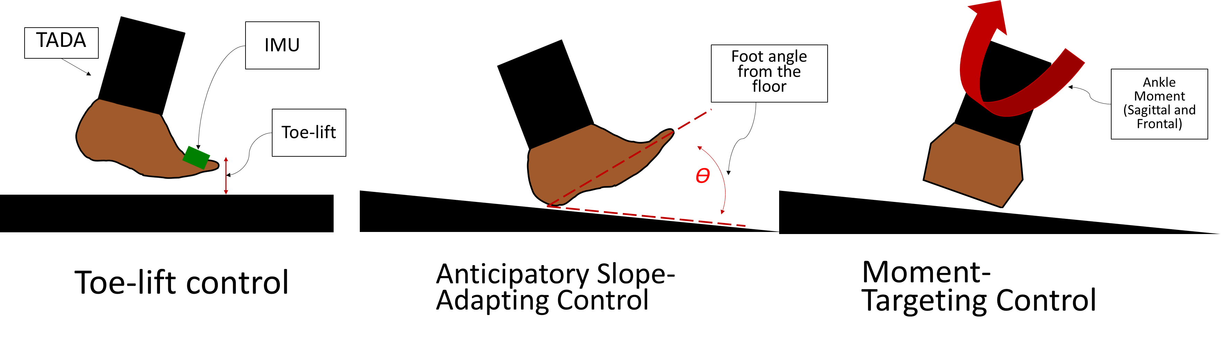
Control Approaches
Notes:
Talk about the 1st and 3rd control approaches
Take out moment-targeting control
Have a backup slide for moment-targeting
Flowchart of inputs and outputs
Use these pictures of the controls on the graphs
Add in method

Slide 17
Toe-lift control
Initial tuning of mid-swing ankle angle to user-preference
Evaluate minimum toe clearance (MTC)
MTC is lower on passive prostheses¹ and a lower MTC contributes to tripping²
Does active dorsiflexion of the TADA raise the MTC?
Notes:
Neutral to desired back to neutral
Neutral is what people setting in tuning

Slide 18
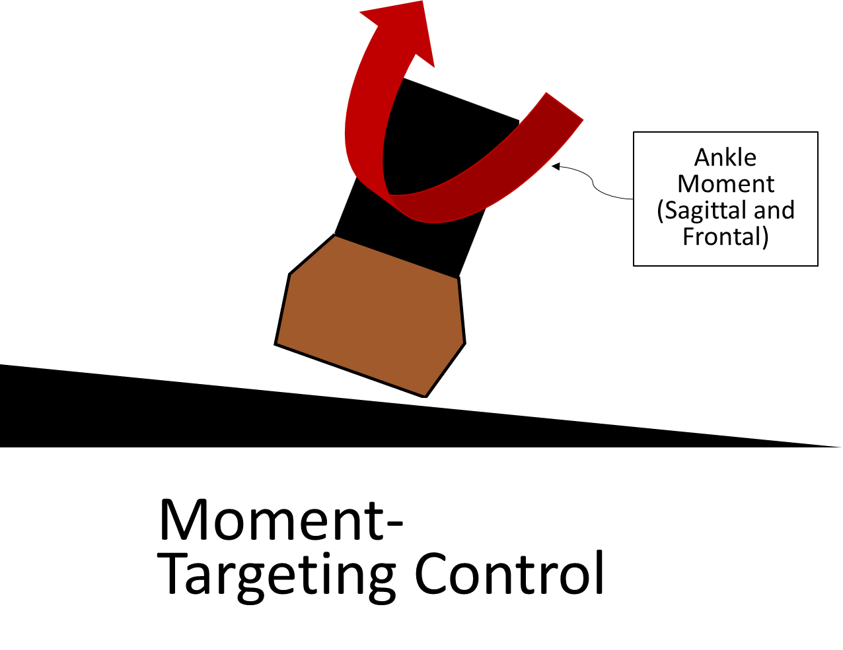
Moment-Targeting Control
Initial tuning of stance angle to a chosen multiple (0.5-1.5) of peak ankle moment from neutral TADA walking
Evaluate resulting ankle angles
Do ankle angles with targeted moments have similar values to intact side or non-disabled ankle angles?
Notes:
More references
Is the resulting ankle angles for having a choice of moments? Biomemetic

Slide 19
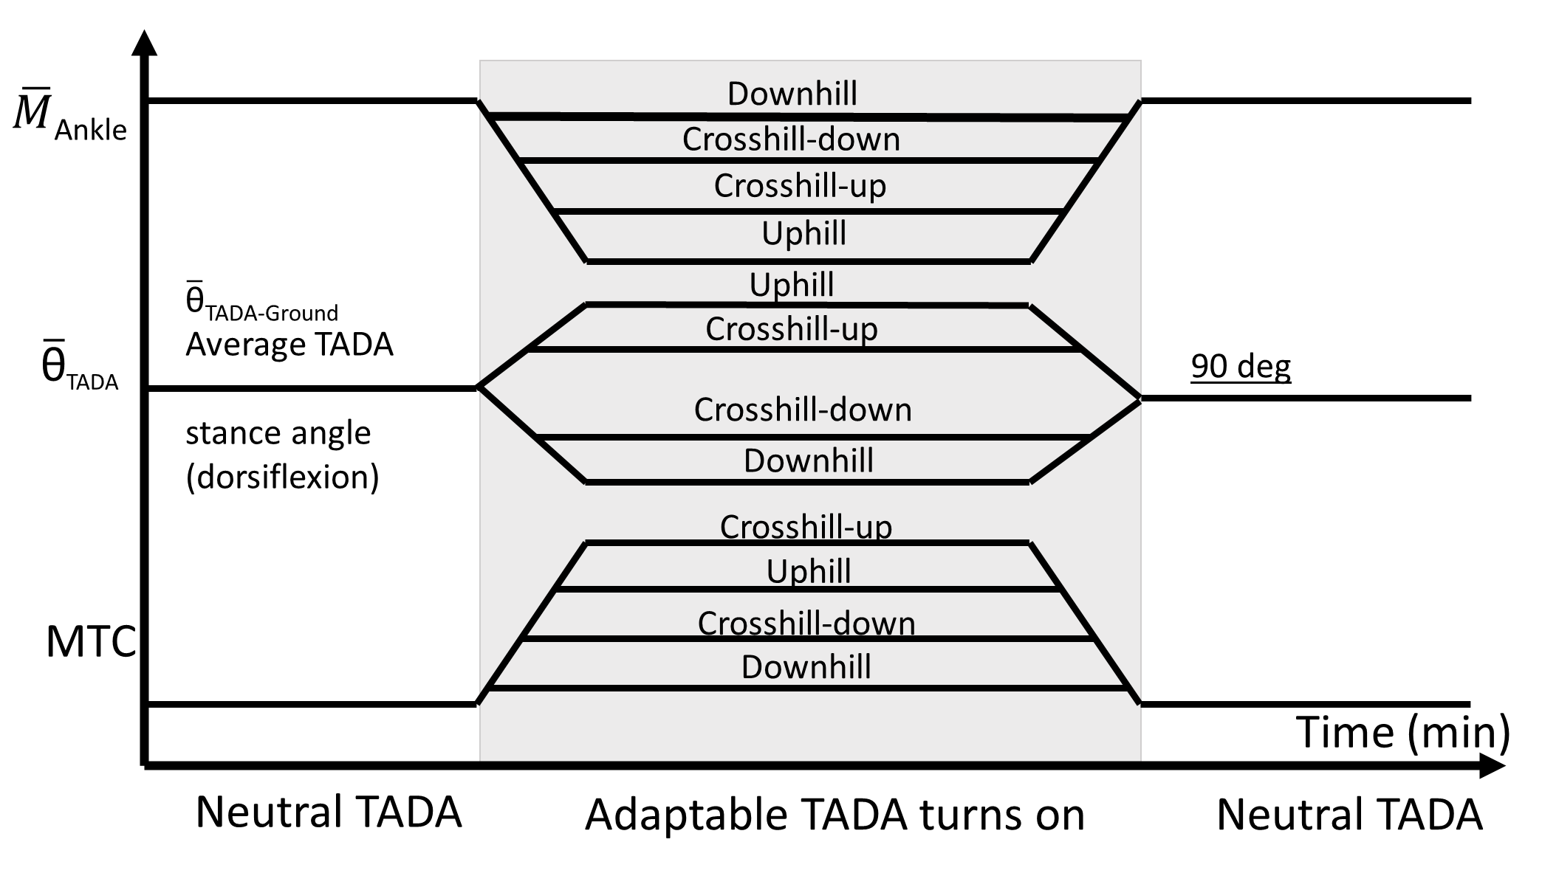
Aim 2
Outdoor tests with persons with transtibial amputations
Walk in square laps on a sloped surface
Notes:
Give brief descriptions

Slide 20
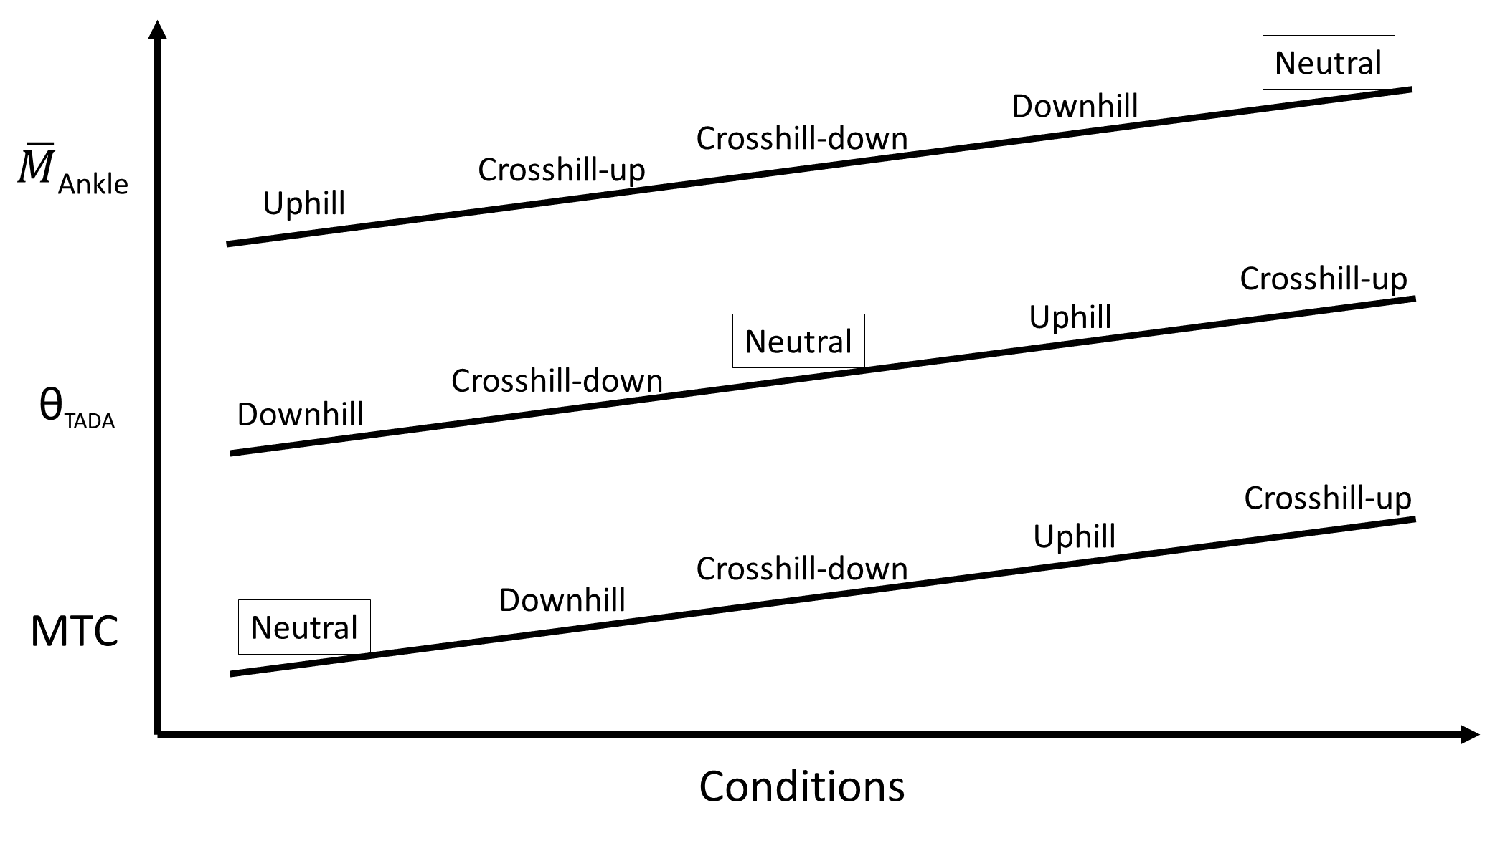
TADA motor control

